Slide 1
Start A New You
Individual Project
Krysta Valenzia

Slide 2
Introduction to Website
Most of what we do is revolved around food. I was looking to create a program that has a mixture of a few different key aspects of life that will make it easier on all the everyday people to create a better lifestyle for themselves. When I say “everyday people” I mean those that don’t feel up to cooking some night and just want to order out. Those that need a little more motivation to work out, or those that just need to have a way to track what they are doing.

Slide 3
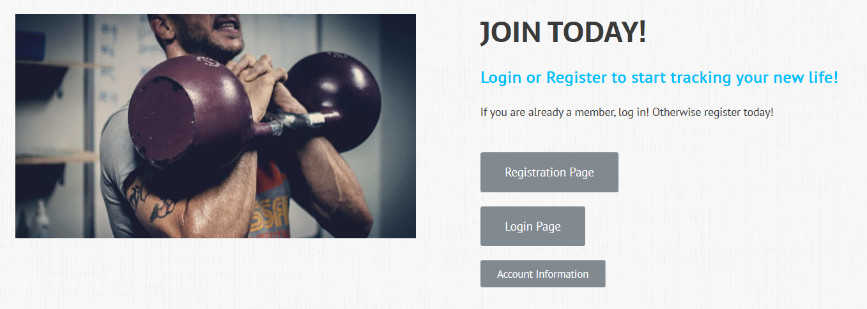
Login and Security
Separate admin login
Registration and Login options available
Stored in database that is only accessed by admin
Account Information
To change/edit/delete account
https:// SSL
Prevents from hackers being able to access website by using extension like jpg png
Overall better safe space for user data

Slide 4
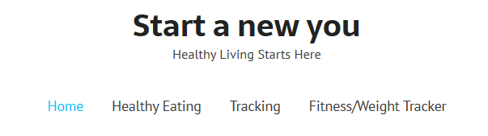
Pages
Home
Healthy Take Out Options
Start Tracking
Registration & Login
Healthy Eating
Get MotoPress Plugin
Redirect to sight with API Plugin
Tracking
BMI Calculator Plugin
Calorie Calculator Pro
Protein Intake and Water Intake
Fitness/Weight Tracking
RapidAPI Fitbit
Clearwise Fat Secret
Fitness Tracker Plugin
Did not need about me page

Slide 5
Tools Used
x10 Host Premium
WordPress.org
GitHub
EdamamAPI / RapidAPI
Downloadable Plug-Ins
JavaScript/HTML

Slide 6
Issues and Set Backs
Plugin Issues
API downloads

Slide 7
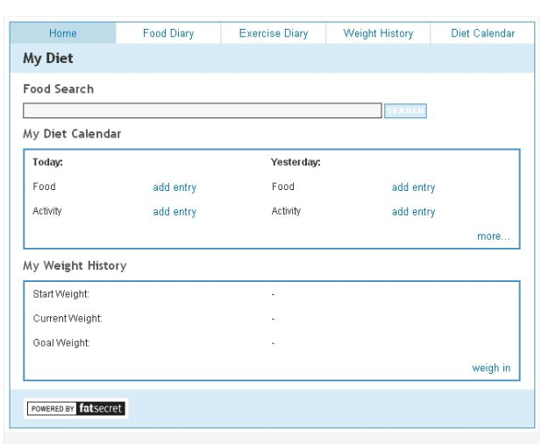
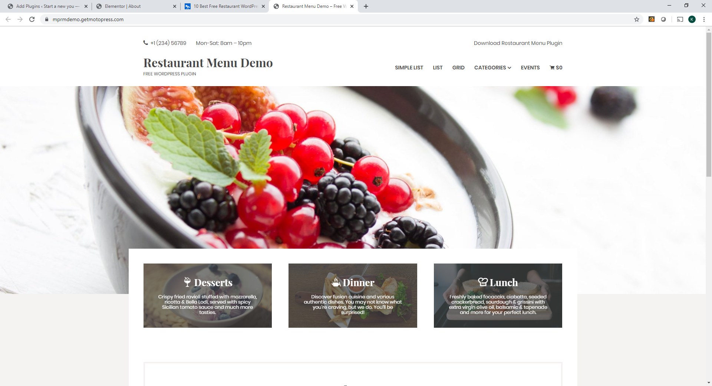
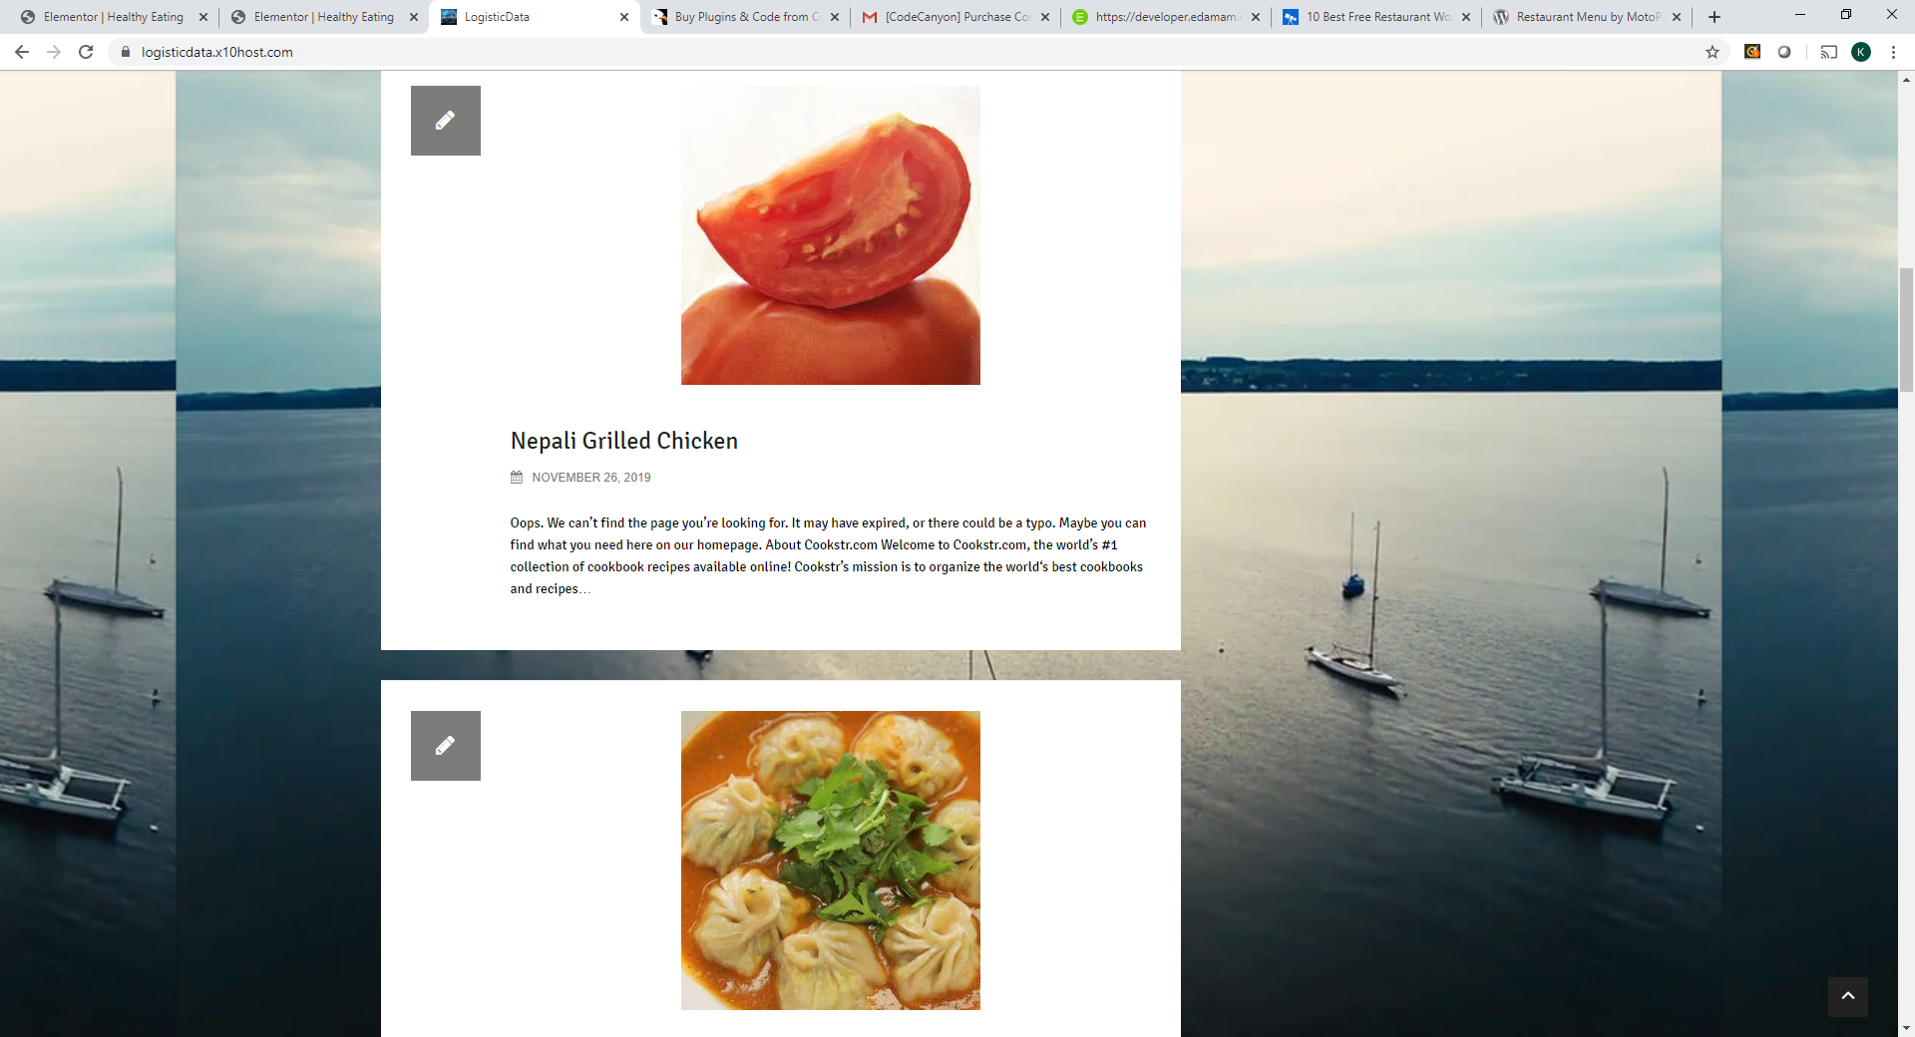

Slide 8
Link to Page
http://startanewyou.x10host.com/

Slide 9
Sources
https://github.com/4krysta/IndividualProject412
http://startanewyou.x10host.com/wp-admin/
https://clients.x10premium.com/login
https://developer.edamam.com/
https://rapidapi.com/spoonacular/api/recipe-food-nutrition
https://codecanyon.net/item/recipeomatic-automatic-recipe-post-generator-plugin-for-wordpress/20410628

